Slide 1
Trimble Connected Community Overview
Mokana S

Slide 2
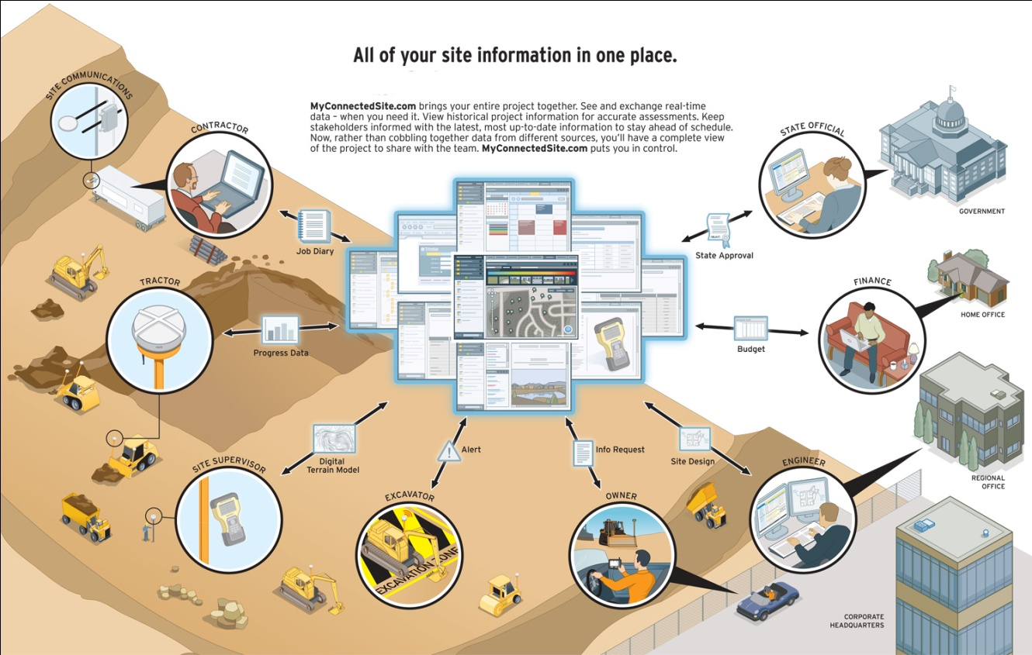
TCC Mission
Enable the secure sharing and aggregated viewing of data with authorized people and devices from anywhere with an internet connection

Slide 3
What is TCC?
Hosted web service with monthly subscription
Provides tools to connect devices, people, workgroups and project partners
Security/Role/Permission Infrastructure
Member ID/Group Management
Web page creation
File repository and services
Spatial view of information (Visual Organizer)

Slide 4
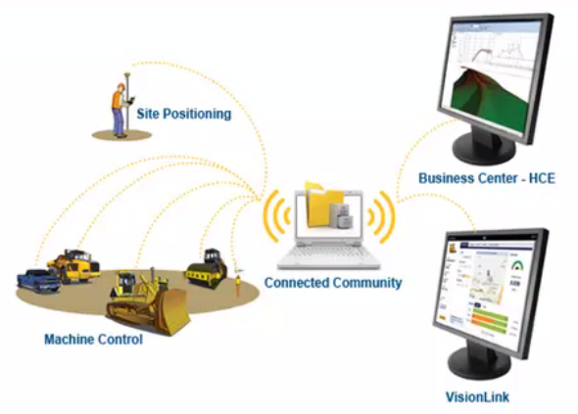

Slide 5
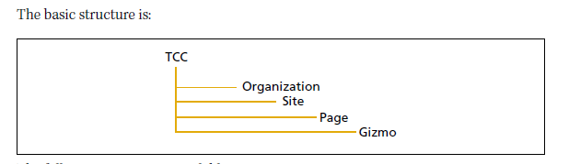
Organisation,Site and Page
An organization contains sites (similar to websites). A site contains pages (similar to web pages). A page contains gizmos. which are specific tools for storing and sharing information.

Slide 6
Site,Pages Cont…
Advanced structure An organization can have multiple sites.
A site can have multiple pages. A page can have multiple gizmos.
You can easily share information with other members in your organization. and your organization can also share information with other organizations (partners).
Demo

Slide 7
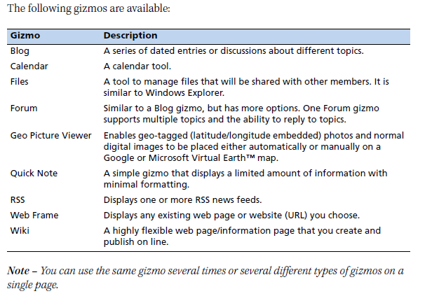
Introduction to Gizmo
Why is the name Gizmo ? Find Out ….

Slide 8
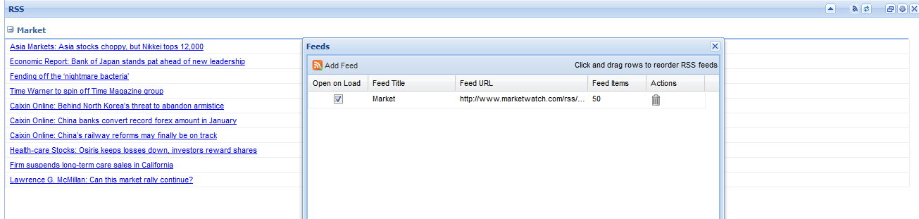
Few types of Gizmo
Legacy Gizmo : Calender and RSS viewer
RSS viewer: Really simple syndication is a family of Web feed formats uses to publish frequently updated items like blog entries,news,headline etc in standardized formats

Slide 9
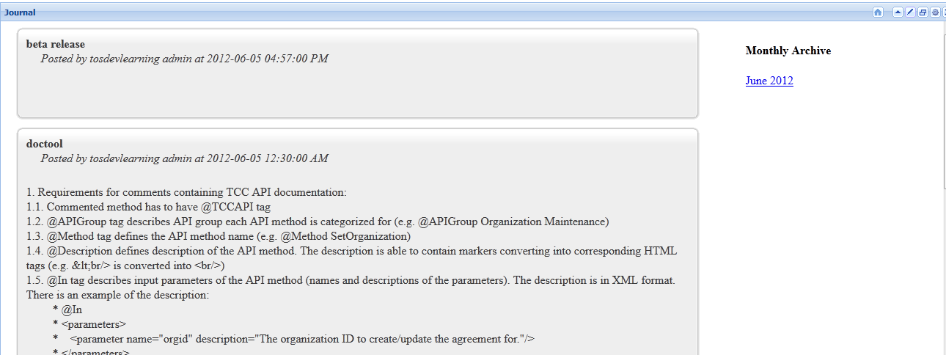
Gizmos – Cont..
Journel :Keep your project updated with latest information. Journels are a series of data entries about specific topics

Slide 10
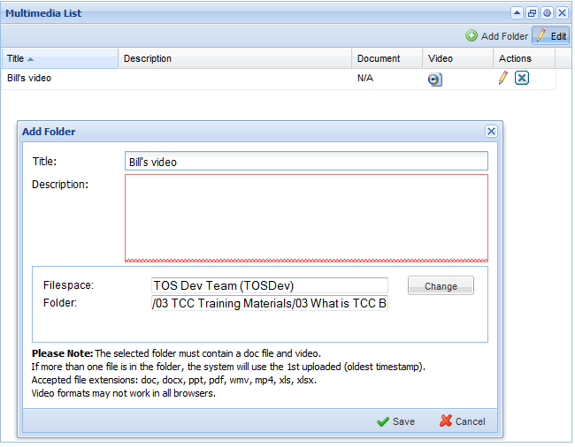
Gizmos – Cont..
Multimedia List Multimedia List:Quickly publish a list of videos and documents in table format

Slide 11
TCC Membership Gizmo
Using TCC Membership details we can access members, devices, groups and organization properties of other organizations.
Community admins can access members, devices, groups and organization properties of all organizations, using TCC Membership details gizmo.
You should create partner inorder to view other org members/devices/groups.. we can give them access to our resources
We create tags inorder to change/edit members/devices/groups from other org
Demo on Gizmos

Slide 12

Member overview
Anyone granted a User ID to access your organization is called a member. A member belongs to a specific organization. There are two types of members: Users Guests
Users and Guests are treated the same way within the TCC. except that guests cannot be made administrators. The two groups are available to help organize members. For example. you may set up all employees as Users and all nonemployees as Guests.

Slide 13
ACL
Access control List
Consolidated key, that is assigned to some resource to members, groups, devices and servers.
Resources are filespaces, folders, calendars, forums, sites, pages, external service credentials, dynamic and static mountpoints.
External service credentials are used by TrimView TCM, GeoManager layers of VO. These services are outside of the TCC and credentials are used to keep information like login, password, organization for connected to these services.
Basic permission instances in the TCC are owners, editors and viewers. But since introductions of the application services, users, that create their own applications can create their own permission instances, for example R2R application uses such permission as license manager, e.t.c.

Slide 14
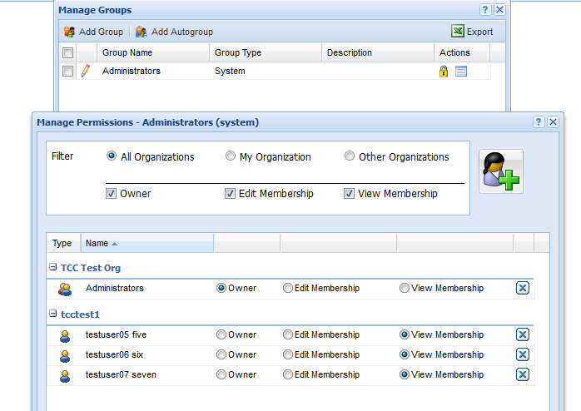
ACL –Cont..

Slide 15
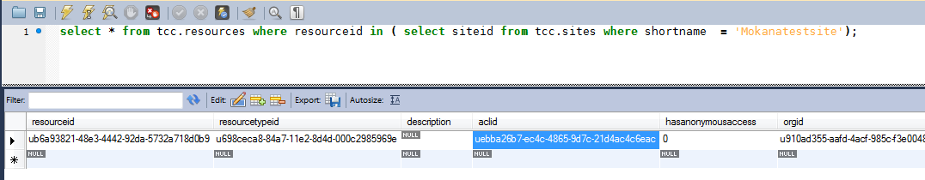
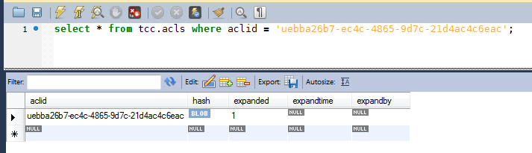
ACL in DB

Slide 16
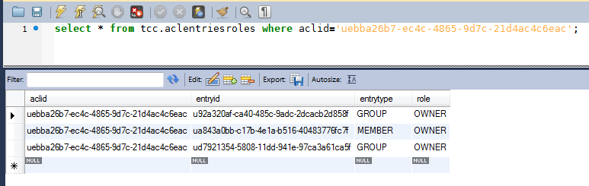
ACL in DB – Cont..

Slide 17
Groups
A group is a collection of members. Putting members into groups and selecting a group to assign permissions to is more efficient than selecting each individual member.
By default, each organization has the following groups: Administrators — All members who have administrator privileges. AllUsers - All members defined as users. AllGuests — All members defined as guests.
You can create additional groups. Trimble recommends that you create groups based on members who should have identical permissions to sites, pages. filespaces. and forums.

Slide 18
Auto Groups
Groups that contain organizations are called autogroups. An autogroup can contain more than one organization. Permissions are assigned to an autogroup in the same way as to a regular group. By adding an organization to an autogroup. the group permissions are imparted to all members (both users and guests) in the organization depending on the autogroup setting.
For example. Trimble wants all members in all TCC organizations to access the TCC Support site and it will take too much administration to update the permissions to the TCC Support site every time a member is created in any organization. Trimble creates an autogroup containing all existing TCC organizations and also assigns appropriate permissions to the TCC Support site, its pages. and to the content. Now when a new TCC organization is created, they are added to the autogroup. When a member is added to any organization, they automatically become a member of the autogroup and they have appropriate permissions to the TCC Support site.

Slide 19
Nested Group
Demo on Groups, Autogroup
Exercise: Find out what is nested group? How can it be created and why do we need nested group

Slide 20
Filespaces
A structure for holding and sharing files is called a filespace. It is much like the file structure on your computer. Filespaces can be created as needed. In the TCC. filespaces hold files that: can be easily shared with other members are required by blogs. files. Geo Picture Viewers, or wild gizmos

Slide 21
Exercise
Create members and assign permission as per below table
Login in as the member and check the behaviour of site, pages, gizmos, filespaces
E.g. of Test instance : https://www.nitrogen.myconnectedsite.com/ orgadmin/tcctest/test
www instance : https://www.myconnectedsite.com/ - tosdevlearningadmin/tosdevlearning/sathya

Slide 22
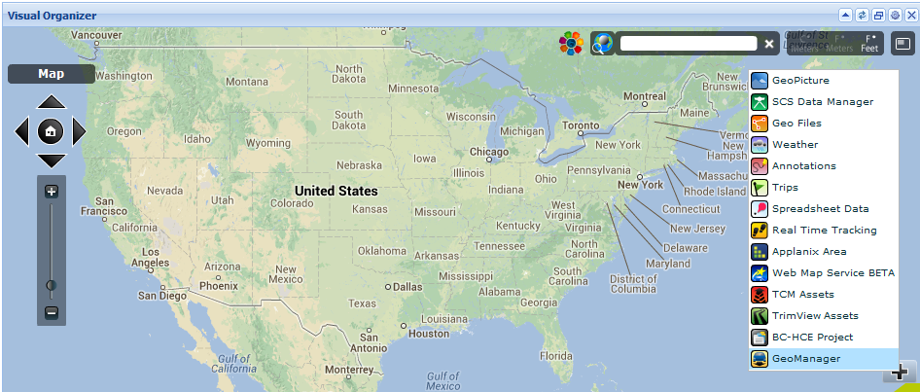
VO Layers

Slide 23
Different VO Layers
Geo Picture
SCS Data Manager
Geo Files
Weather
Annotations
Trips – Ignore for now
Spreadsheet Data
Real time tracking
Applanix Layer
Web Map service BETA – Ignore for now
Trimview Assests
BC- HCE Projects
Geomanager
filespace name : tcctestfs00

Slide 24
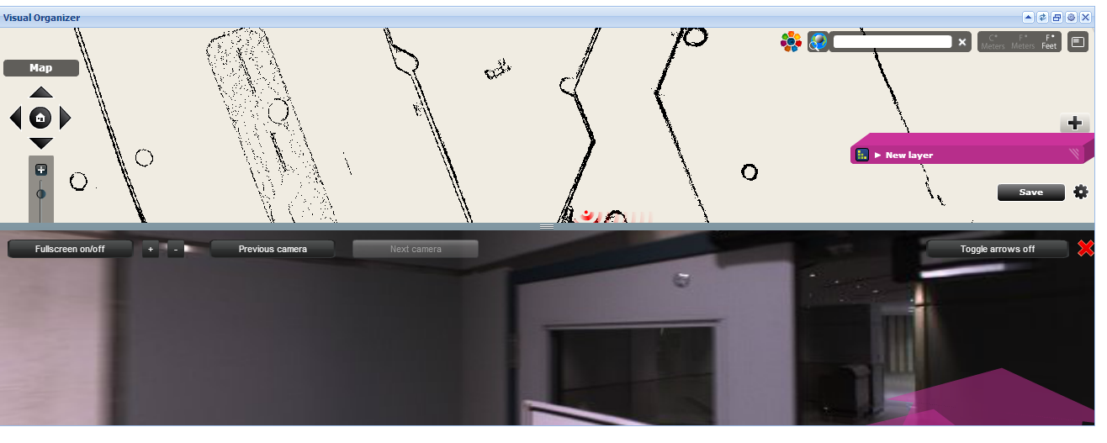
VO Layers Cont..
Applanix Layer : The Applanix system creates a 3-D visualization of the selected space, such as the interior of a building.
The Visual Organizer Applanix layer enables display of this type of data. The data is in the form of a folder with files and sub-folders of a particular structure.

Slide 25

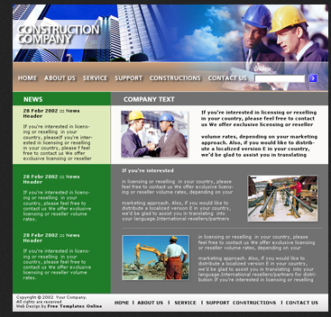
Exercise
Create a construction site similar to below examples

Slide 26
Exercise
Pages :
Home Services Projects Contact Us
Home page : Name of the company, design a logo , About the company,RSS feed gizmo(news sections),calender gizmo showing company holidays
Services: Use Quicknote gizmo,Forum gizmo,VO (to track devices)
Projects : Use Journel,Multimedia list,Quicknote
Contact Us : appropriate gizmo
Note: Use Webframe and Wiki gizmo wherever applicable. Be creative as possible

Slide 27
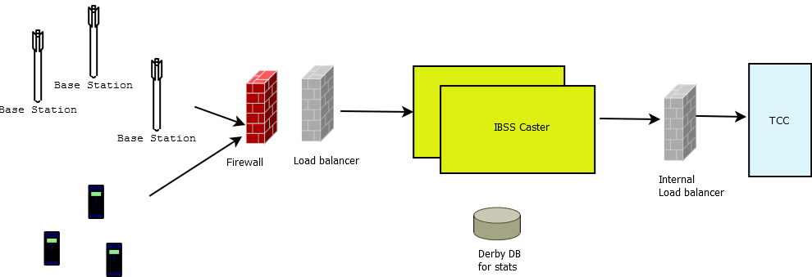
IBSS Caster
Acronym | Description
TCC | The Connected Community
Base | A stationary device that streams GNSS correction data as NMEA strings over HTTP
Rover | A mobile device that subscribes (or connects) to data from a base.
Base station | Is actually a mount point.

Slide 28
